Slide 1

Aditya Case Study Assessment:
Organization Profiling Case Study
Data Riders-Team7
Sailaja Velagala(lead)
Suresh Repaka
Ajay Nalla
Suseela Jerripothula
Narala Prasanth
R Kusuma Sri Aruna
Bolla Sai Hemanth

Slide 2

Business Objective, Understanding and Approach
Business Objective
Understanding
Business Objective
Understanding
The CEO of a firm wants to know how things are going in his firm and certain indicators that pose any kind of future risk
The CEO also needs assistance in performing some quantitative analysis and use the generated insights as a guide to intervene at the right time, before things go worse. On the contrary, if the analysis discovers anything positive, the CEO plans to reward/ acknowledge the concerned personnel/ Department leads
Based on the clients requirements, we need to perform some quantitative analysis to know more about the employees and performance in several aspects.
By keeping in the view of company’s productivity and growth, we need to identify the indicators of future risk if any before things go worse

Slide 3
Approach
Splitting the given data into current working employees and Terminated employees,
We will work on identifying the performance score and engagement in work of the current working employees to know about the performance of employees.
We need to concentrate more on Termination reason of the employees and satisfaction score of their employees to improve company's policies if required
We need to observe salary distribution of the current working employees
We need to identify the department / the managers with more number of projects being done so that the company can conduct recognition programmes to boost organizations reputation
We will try to identify if something wrong w.r.t hiring and if it posses any future risks

Slide 4
Analysis
Data Preparation & EDA
Variable Creation and selection
Sub-setting the dataset to relevant variables/records
- Terminated
- Performance score
- Engagement survey
- Recruitment source
- Satisfaction score
Uni-variate analysis conducted on all relevant variables
Bi-variate analysis conducted on all meaningful variables
Outliers identified in variable salary in the range 200000-250000
67% of missing data from termination date,3% from engagement survey
5 new variables are created as a part of feature engineering
Termination rate is used as key reference in analyzing the data over the years
Active employees count over the years is used as reference key

Slide 5
Extended Data Dictionary (EDD)
 | Variable Type | Min | Pc 1% | Pc 5% | Pc 25% | Pc 50% | Mean | Pc 75% | Pc 95% | Pc 99% | Max | % Missing values | % Unique values
Salary | Integer | 45046.00 | 45398.800 | 46999.5 | 55501.5 | 62810.00 | 69020.6848 | 72036.0 | 108106.5 | 177250.0 | 250000.0 | - | 99
Terminated | Integer | 0.00 | 0.000 | 0.0 | 0.00 | 0.00 | 0.334405 | 1.0 | 1.0 | 1.0 | 1.0 | - | 0.643
Manager ID | Integer | 1.00 | 1.000 | 2.0 | 10.00 | 15.00 | 14.570957 | 19.0 | 22.0 | 39.0 | 39.0 | 3 | 7.395
Engagement_Survey | Float | 1.12 | 1.822 | 2.4 | 3.36 | 4.28 | 4.110000 | 4.7 | 5.0 | 5.0 | 5.0 | - | 38.264
SatisfactionScore | Integer | 1.00 | 2.000 | 3.0 | 3.00 | 4.00 | 3.890675 | 5.0 | 5.0 | 5.0 | 5.0 | - | 1.608
Num of spl Projects | Integer | 0.00 | 0.000 | 0.0 | 0.00 | 0.00 | 1.218650 | 0.0 | 6.0 | 7.0 | 8.0 | - | 2.894
Dayslate30 | Integer | 0.00 | 0.000 | 0.0 | 0.00 | 0.00 | 0.414791 | 0.0 | 4.0 | 6.0 | 6.0 | - | 2.251
Num of Absences | Integer | 1.00 | 1.00 | 2.0 | 5.00 | 10.00 | 10.237942 | 15.0 | 19.0 | 20.0 | 20.0 | - | 6.431

Slide 6
Key Findings from EDD:
Average salary of an employee is 69000
75% of the employees salary lies below 72000
Few of the employees get the salary in the range of 200000 and above(mostly CEO or Executive Director)
we identified more than 75% of the employees are greatly engaged in the work with engagement survey greater than 3
Very few employees are showing less engagement in the work
Average satisfaction score give by an employee is 3.8
25% of the employees are fully satisfied with the company
Only 5% of the people done more than 6 projects
Less than 50% of the people are being absent for atmost 10days

Slide 7
Feature Engineering – New variables created
S.No | Variable Name | Variable Type | Description
1 | Age | Numeric | Employees age is calculated using DOB with present year as 2018-12-31
2 | Tenure | Numeric | Tenure has been created using variables hiring date and termination date
3 | Tenure bins | Object | A numeric variable tenure converted to Bins based on meaningful threshold
4 | Salary bins | Object | Salary variable converted to Bins based on percentiles
5 | Termination rate | Numeric | Year wise termination rate is calculated using termination count and active employee count

Slide 8
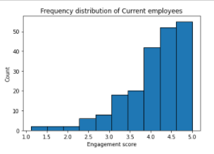
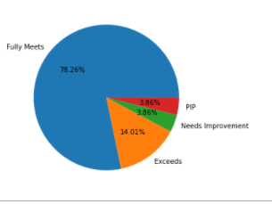
Analysis Results
Employees Performance Dashboard
Fig: Graph showing the count of engagement survey
Fig: Pie chart displaying the employees performance score
Key Findings :
Employees overall performance need to be assessed using engagement survey and performance score
18% of the employees are fully engaged in the work with engagement survey 5
Where about 66% of the empoyees are having engagement survey>4
78.26% of employees are having performance score –’fully meets’
14.01% employees performance exceeded in their work

Slide 9
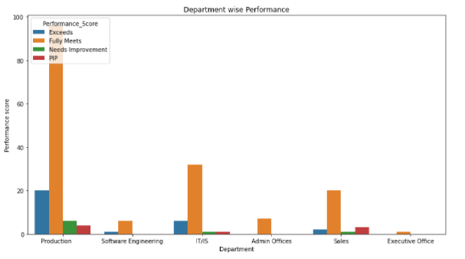
Department wise Performance
Key Findings :
The current working employee performance is better in following departments:
~ Production
~ IT
Nearly 46% of current working employees performance in production department is ‘fully meets’.
Fig: Graph displaying Department wise performance

Slide 10
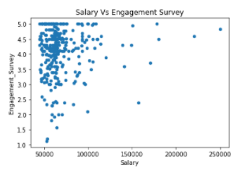
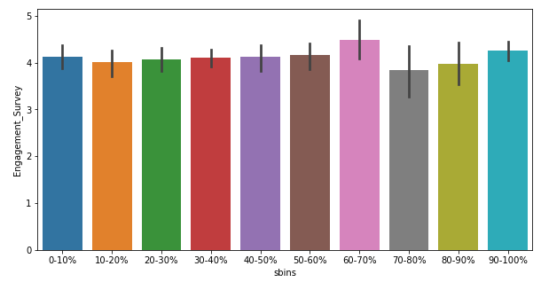
Salary Distribution
Fig:Engagement_survey for equivalent salary bins
Key Findings :
Obviously high paid showing great performance but majority found in low salaried
Few of the employees get the salary in the range of 200000 and above(mostly CEO or Executive Director)
We found that majority of the employees with high engagement in the work are paid less
60-70 range salaried are showing great engagement
The company should concentrate much on these employees in order to make them sustain in the company

Slide 11
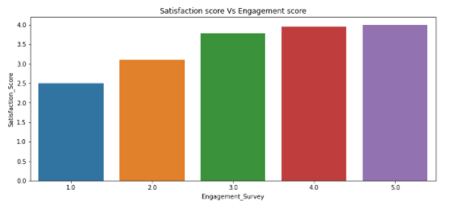
Employee satisfaction analysis
Fig:Graph showing employee satisfaction score for equivalent engagement survey
Key Findings :
Here Engagement Score is driving the Satisfaction score of the employees.
Highly engaged employees are having high satisfaction score.
Almost 36% of employees are with satisfaction score of 3.0 which indicates dissatisfaction of employees.
High satisfaction employees count is gradually decreasing in the firm in the last 2 years

Slide 12
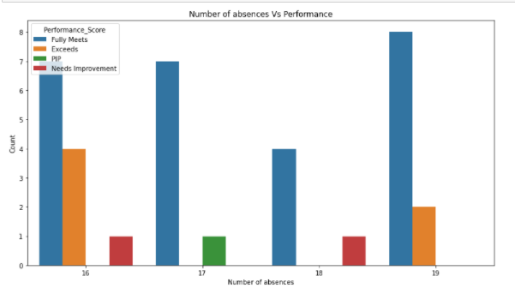
Performance of absentees
Key Findings :
Nearly 35 active employees are being irregular to the work
But the performance of these irregular employees was observed to be good
Nearly 66% of the irregular employees were with Excellent performance
Fig:Graph displaying the performance of the absentees

Slide 13
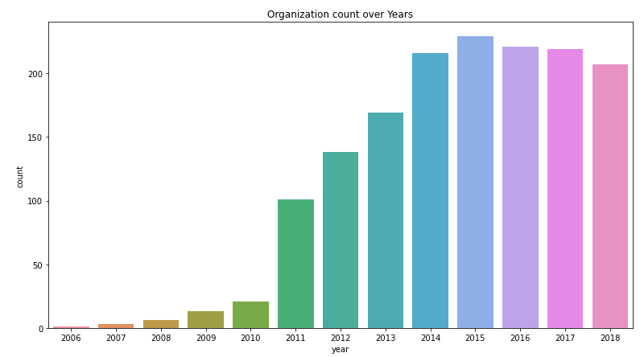
Year wise organization count(active employee count)
2014,2015,2016 are the top three years where active employee count is high
Fig: Organization count over the years from 2006 to 2018
Key Findings :
The active employee count in the organization from 2006 to 2015 is increasing gradually but
the company has been experiencing low active employee count since 2016-present
About 26% of hiring is done in the year 2011 which is the top hiring done all over the years
Low Hiring count is one of the reason identified for decrease in organization count from 2016-2018
Termination rate is gradually increasing in the recent years from 2015-2018

Slide 14
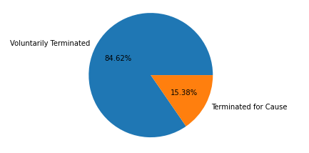
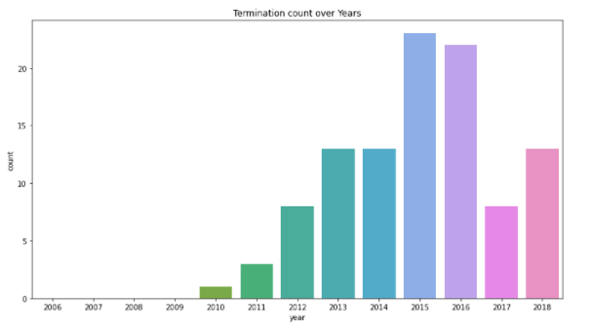
Study on Termination and Reasons for termination
Fig: Pie chart showing the reason for termination
Fig: graph showing the termination count over years
Key Findings
Voluntary termination which is higher, about 84% ,in this area plays a critical role in future risk of attrition rate in the company
Another position ,unhappy, more money, career change ,hours are the key aspects identified for the attrition in the company
10% of the employees in the year 2015 have been terminated ,this is the highest termination rate noted
In the Year 2016 also termination rate is high with 9.95% of employees being terminated
It should be noted that 6% of the employees are terminated in the year 2018 which indicates the risk of attrition

Slide 15
Recommendations to the Client
Organization count has been decreasing in the recent years from 2016-2018 ,we suggest the client to increase hiring count from the coming years.
More number of fresher's can be recruited through the reliable recruitment sources like Indeed, Linked-in, Employee referral.
Current working Employees with very low performance score can be terminated from the firm for better productivity.
The firm can reward the managers who had done more number of projects to encourage them. The best three managers in the firm are listed below:
-Peter Monroe
-Simon Roup
-Brian Champaigne

Slide 16
Case study of the problem (1-Slide summary)
Key Considerations
Approach & Solution
Insights/ Recommendations
The Key variables considered in this analysis are :
- Age
- Tenure
- Termination Rate
- Salary bins
After splitting the given data into 2 parts namely current working employees and terminated employees
we had performed the analysis on relevant variables to avoid future risks and for better productivity of the firm
More number of special projects are done in the IT department.
Most of the talented employees are present in production ,IT department.
Organization count has been decreasing in the recent years from 2016-2018 ,we suggest the client to increase hiring count from the coming years
More number of fresher's can be recruited through the reliable recruitment sources like Indeed, Linked-in, Employee referral

Slide 17


